Slide 1
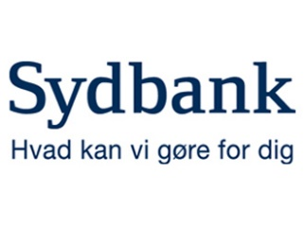
TESTIMONIAL
SYDBANK
Sydbank is Denmark’s fourth largest financial institution, and customer service is extremely important to the bank. It provides customer service from several locations around the country, and aims for constant availability and for customers to have their needs met by the first employee answering their call.
With customers starting to request different kinds of services, Sydbank’s customer service needed a completely new set of functions that would enable them to handle approximately 100.000 incoming calls a month.
Sydbank was already using Zylinc Contact Center, but wanted additional functions to cater for their 2.000 employees. A flexible system that could be developed further was also a criteria.
Zylinc’s Solution
Benefits – Enterprise
Benefits – User
Together, Sydbank and Zylinc identified the bank’s specific needs. Based on the results, Zylinc specifically tailored its development for Sydbank’s needs.
The result was Zylinc Service Center, which is a hybrid between a switchboard system and the Contact Center system.
The call flow in Zylinc Service Center works by automatically sending all incoming calls to the company’s main lines directly to Customer Service. The same applies to incoming calls made directly to an employee.
Sydbank started implementing the system while Zylinc kept an ongoing process of optimizing the functions.
With Zylinc Service Center, Sydbank now provides an excellent customer service and fully optimizes internal resources.
The implementation of Zylinc Service Center meant that Sydbank was able to keep their strategic focus on customer service.
The Service Center contains a wealth of information that makes it easy to serve customers who call the bank.
It also positioned Sydbank to realize the bank’s strategic focus of solving customer enquires quickly.
Easy to transfer calls or see if a specific employee is available.
A customer service agent immediately knows who the customer is, who their personal advisor is, as well as their call history.
If an employee is busy, the customer service agent can quickly look in the calendar of the employee in question and book a call-back appointment.
Customer service departments across the country can assist each other in serving customers, eliminating unnecessary waiting time.
Notes:
1

